Slide 1
Linear Algebra
Lecture 44

Slide 2
Linear Algebra
Lecture 44

Slide 3
Segment VI
Orthogonality and
Least Squares

Slide 4
Applications of
Inner Product Spaces

Slide 5
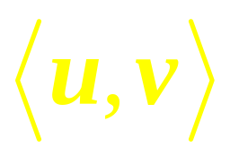
Definition
An inner product on a vector space V is a function that, to each pair of vectors u and v in V, associates a real number and satisfies the following axioms, for all u, v, w in V and all scalars c:
…

Slide 6
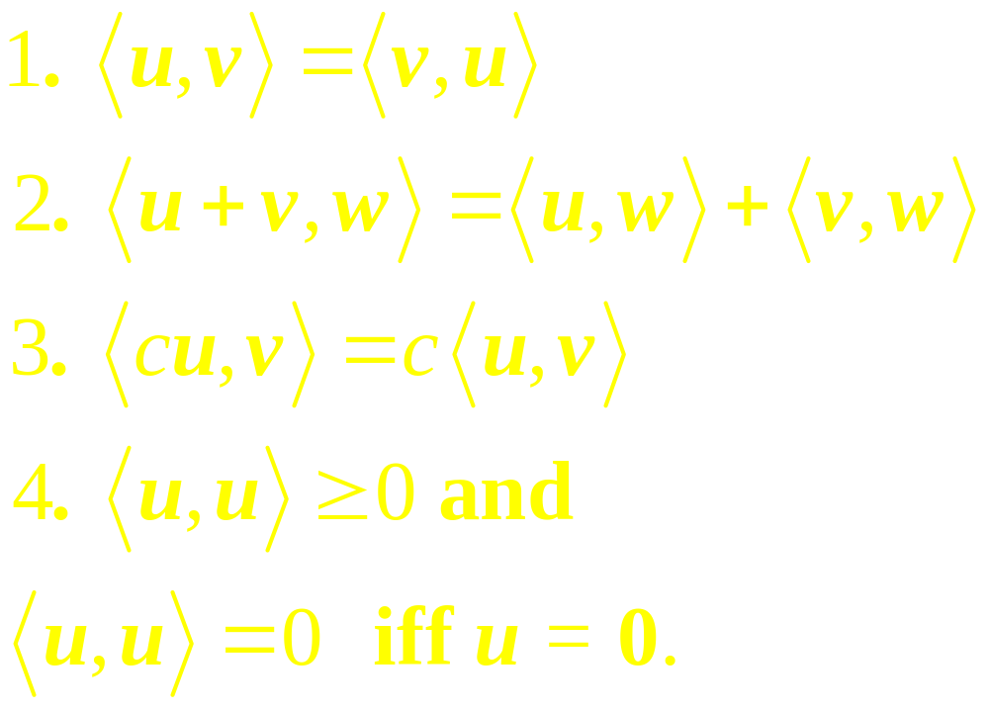
Continued
…

Slide 7
Continued
A vector space with an inner product is called an inner product space.

Slide 8
Least Squares
Line

Slide 9
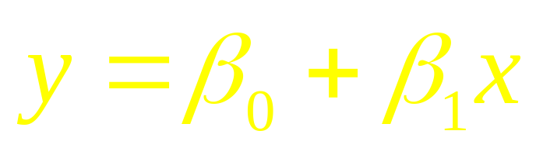
Example 1
Find the equation
of the least-squares line that best fits the data points (2, 1), (5, 2), (7, 3), (8, 3).

Slide 10
Weighted
Least-Squares

Slide 11
Example 2
Find the least squares line
that best fits the data (–2, 3), (–1, 5), (0, 5), (1, 4), (2, 3).

Slide 12
Continued
Suppose that the errors in measuring the y-values of the last two data points are greater than for the other points. Weight these data half as much as the rest of the data.

Slide 13
Trend Analysis
of Data

Slide 14
Example 3
The simplest and most common use of trend analysis occurs when the points t₀, …, t_{n} can be adjusted so that they are evenly spaced and sum to zero.

Slide 15
Continued
Fit a quadratic trend function to the data (– 2, 3), (– 1, 5), (0, 5), (1, 4), and (2, 3).

Slide 16
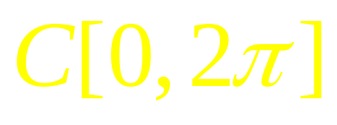
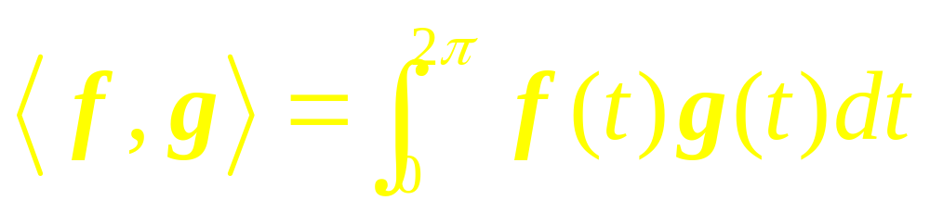
Example 4
Let have the inner product
and let m and n be unequal positive integers. Show that cos mt and cos nt are orthogonal.
…

Slide 17
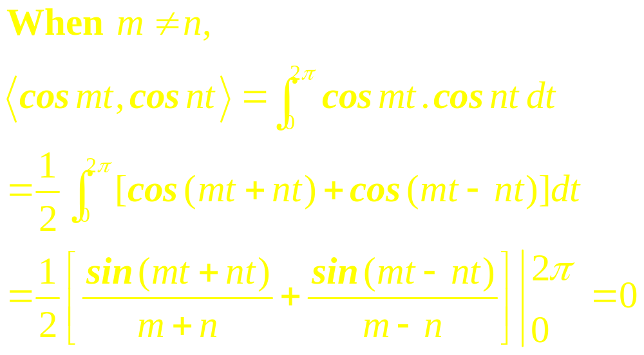
Solution

Slide 18
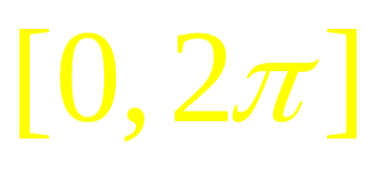
Example 5
Find the nth-order Fourier approximation to the function f (t) = t on the interval .

Slide 19
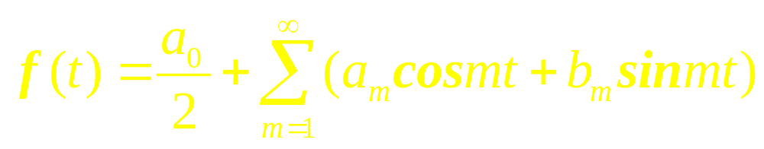
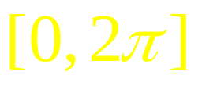
This expression for f (t) is called the Fourier series for f on .The term a_{m} cos mt, for example, is the projection of f onto the one-dimensional subspace spanned by cos mt.
.

Slide 20
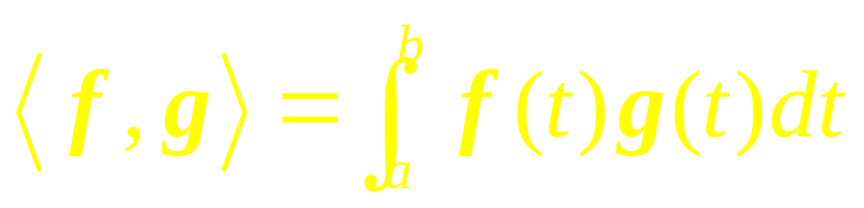
Example 6
Let q₁ (t) = 1, q₂ (t) = t, and q₃ (t) = 3t² – 4. Verify that {q₁, q₂, q₃} is an orthogonal set in C[-2, 2] with the inner product
…

Slide 21
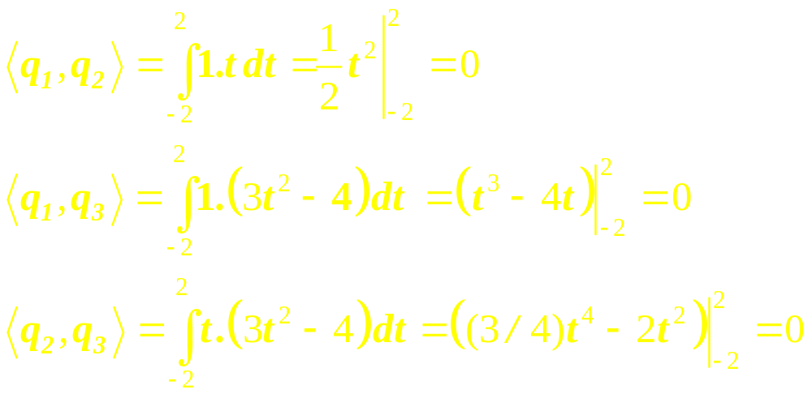
Solution

Slide 22
Example 7
Find the first-order and third-order Fourier approximations to
f (t) = 3 –2 sin t + 5 sin 2t – 6 cos 2t

Slide 23
Linear Algebra
Lecture 44

